Slide 1



Revolutionizing Tomorrow:
A look step into the future with Digital Technology

Slide 2
TABLE OF CONTENTS
2
What is Digital Technology?
4
Emerging frontiers in Technology.
3
Impact of Digital Technology on sustainable economic growth.
Benefits of Digital Technology.
5

Slide 3
WHAT IS DIGITAL TECHNOLOGY?
Digital technology refers to the use of digital tools, systems and devices that can process, transmit and store information; such as computers and electronic devices in a numerical format (binary). An example of digital technology is computers, smartphones, the internet.
In recent years we have seen how digital technology has impacted the agricultural sector through a system that measures when plants need water and how much water is required, this system saves water and the plants from water excess, therefore producing better quality plants.
AI as the engine of digital technology has allowed us access to virtual assistants like Siri, data analysing, fraud detection in financial systems, e-commerce platforms like Amazon and Takealot, improved customer service through chatbots, medical diagnosis to name a few.

Slide 4
IMPACT OF DIGITAL TECHNOLOGY ON SUSTAINABLE ECONOMIC GROWTH
To delve into the impact of digital technology on sustainable economic growth one needs to first understand the concept of sustainable economic growth.
What is sustainable economic growth?
Economic development that aims to meet the needs of the present without affecting the needs of the future generation.
Sustainable economic growth goes hand-in-hand with job creation, providing opportunities for individuals by fortifying small businesses, uplifting our agricultural sectors and driving overall prosperity. This is in order to protect the ecosystem and foster economic growth and social well being. Digital technology is part of the solution to all of the factors mentioned above. Digital technology is recognised as a driving force for economic growth and innovation.
In South Africa alone statistics have shown that 97% of all households have at least one mobile smart phone, which means high accessibility to job posts, information and services. In recent years South Africa rolled out 5G fibre that makes our economy more competitive as more connectivity solutions help businesses emerge and expand.

Slide 5




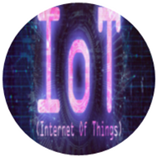

EMERGING FRONTIERS IN TECHNOLOGY
Cloud Computing
A network of remote servers over the internet, allowing users to access resources remotely, offering scalability, flexibility and cost effectiveness.
Artificial Intelligence (AI)
AI is the simulation of human intelligence processes by computer systems to perform human-like tasks, E.g. Self-driving cars and virtual assistants like Siri.
Blockchain technology
Is a reinforcement method of recording and sharing information in a way that makes it difficult or almost impossible to be hacked or manipulated.
The Metaverse
Refers to the 3D virtual reality space where humans are able to experience a computer generated environment from anywhere.
Internet of things
IoT describes a network of connected devices and technology that facilitates communication between devices, cloud and themselves.
Big Data
The name speaks for itself, big data is simply a massive set of complex data that cannot be processed by our traditional software systems. It is typically used when addressing business problems that previously couldn’t be solved.

Slide 6
BENEFITS OF DIGITAL TECHNOLOGY
BENEFITS OF A DIGITAL ECONOMY
JOB CREATION, PARTICULARLY FOR YOUTH THROUGH DIGITAL SKILLS.
INFORMATION ACCESSIBILITY
HIGH EFFICIENCY AND REDUCED PRODUCT PRICES THROUGH AUTOMATED OPERATIONS.
INCOURAGES INNOVATION, WHERE COMPANIES CAN ADOPT AI TO OPTIMIZE PATTERN RECOGNITION IN DATA.
ABILITY TO SHARE AND EXCESS INFORMATION
WE LIVE IN AN ERA DOMINATED BY TECHNOLOGY ADVANCEMENTS AND INNOVATIONS. THESE INNOVATIONS INCOURAGES AN AGILE AND ADAPTATIVE ORGANIZATIONAL CULTURE WHERE COMPANIES ARE BETTER EQUIPPED TO NAVIGATE UNCERTAINTIES, SEIZE OPPORTUNITIES AND ADAPT THEIR STRATEGIES IN A RAPIDLY EVOLVING BUSINESS ENVIRONMENT.

Slide 7
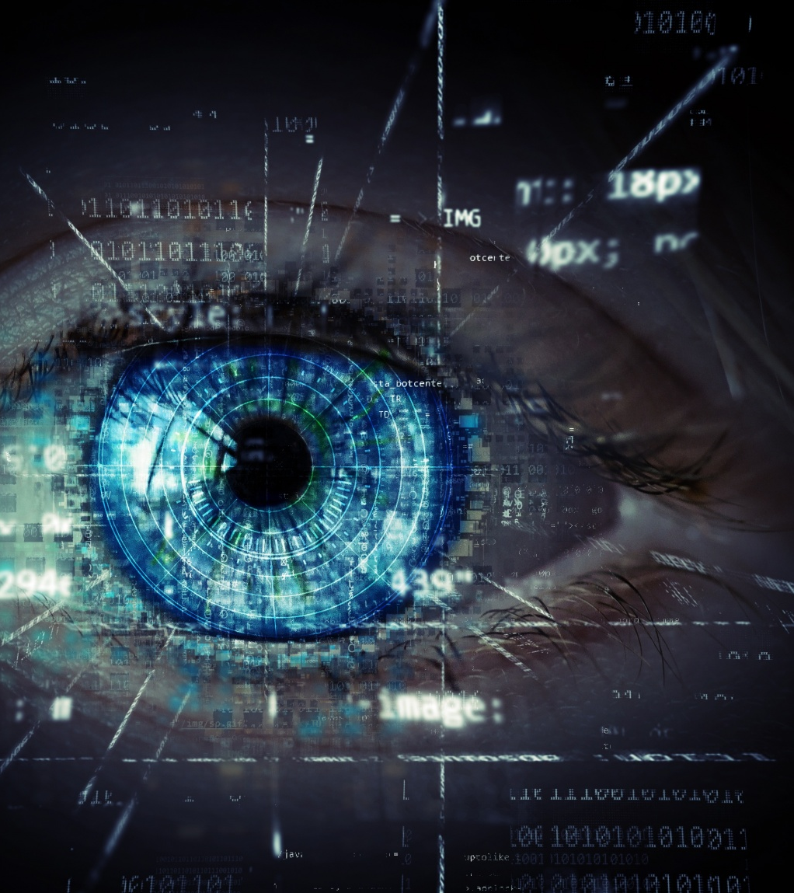

KGOTHATSO MASOGA

